Slide 1
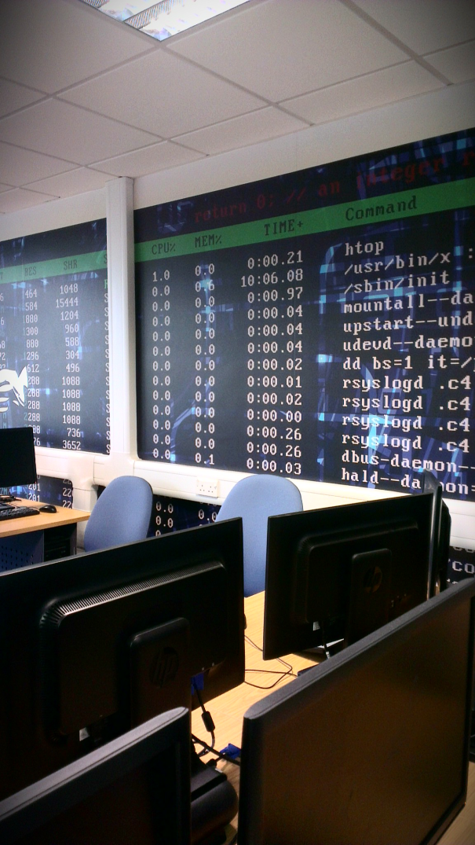
Computing Courses @
Bournemouth University
Presenter: Dr Richard Gunstone
School of Design, Engineering and Computing
The content of this presentation is indicative
and subject to change e.g. due to continuous
improvement

Slide 2

To Be Covered in this Talk ...
What is the computing framework?
Framework ethos and focus
The first year experience
Second year
Placement year
Final year
What we offer and what we want from you

Slide 3

What is the Computing Framework?
A coherent group of 6 related computing/IT degree titles
Deferred choice of final degree title
Common first year of study
Partial specialisation in Year 2
Industrial Placement (Year 3)
Final year (Year 4)
  Choice of degree title and taught units
  Individual project and dissertation

Slide 4
Year 4
(Level H)
Year 2
(Level I)
Year 1
(Level C)
Placement
(Level P)
Graduation

Slide 5

Degree Titles Available
IT-with-business degrees
  BSc (Hons) Business Information Technology (aka “BIT”)
  BSc (Hons) Information Technology Management
Computing degrees
  BSc (Hons) Computing
  BSc (Hons) Computer Networks
  BSc (Hons) Software Engineering
Forensic/Security degree
  BSc (Hons) Forensic Computing & Security
You are able to finalise your choice after the common first year*

Slide 6
Ethos and Focus
A range of degree titles reflecting the breadth of the profession
  Deferred choice of degree title allows informed choice, specialisation, and changes of direction, up to the final year
Common first year, and some common units in second year, ensure coverage of core topics
Industrially relevant education, with excellent employability prospects, underpinned by the research and industrial experience of our staff
  Our courses have always had a practical and professional emphasis
In various forms, all our courses are technical in nature and focus
Accredited by our professional body - the BCS (British Computer Society), building toward Chartered Scientist / Engineer / CITP

Slide 7
Your First Year at BU
Six taught units, studied by all first year students
  Business & Professional Issues
  Computers & Networks
  Programming
  Relational Databases
  Systems Analysis & Design
  User-centred Website Development
Assessment for most units is 50:50 coursework:exam
Coursework – individual and group work

Slide 8
The First Year Experience
Average of six lectures per week
Six one-hour lab or seminar sessions per week, in small groups
  Additional lab support sessions for programming
Modern, well-equipped computer labs, open 24 hours a day, 7 days a week
First year tutors, for academic and pastoral care
Peer-Assisted Learning (PAL) scheme in operation
Integrating all the first year learning – Computing in Business Week
  Practical group work on a development project

Slide 9
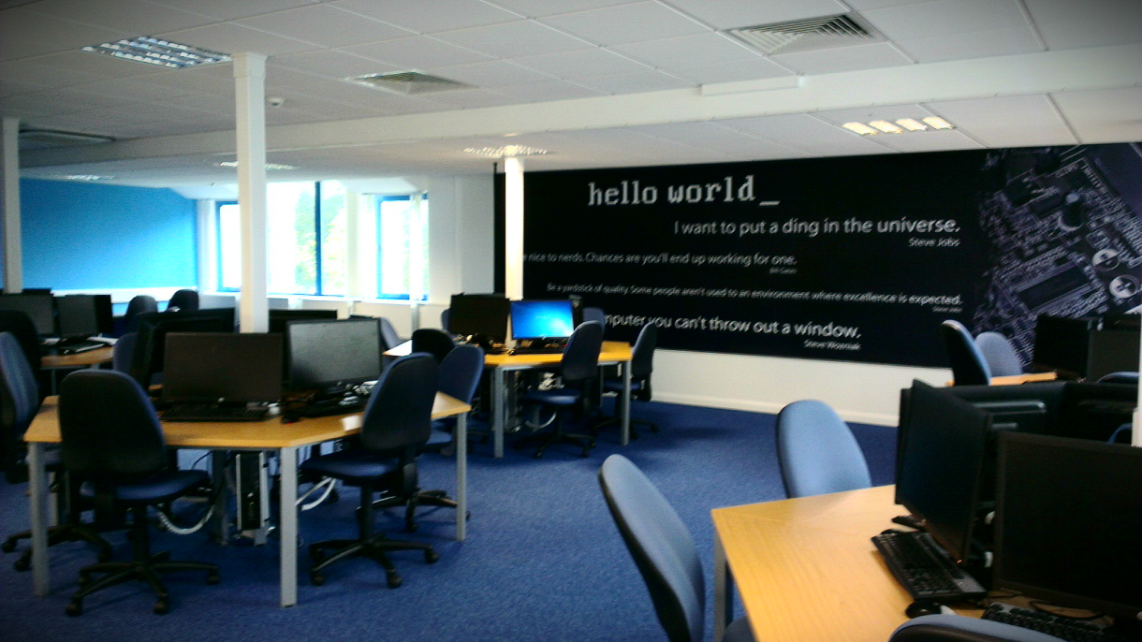
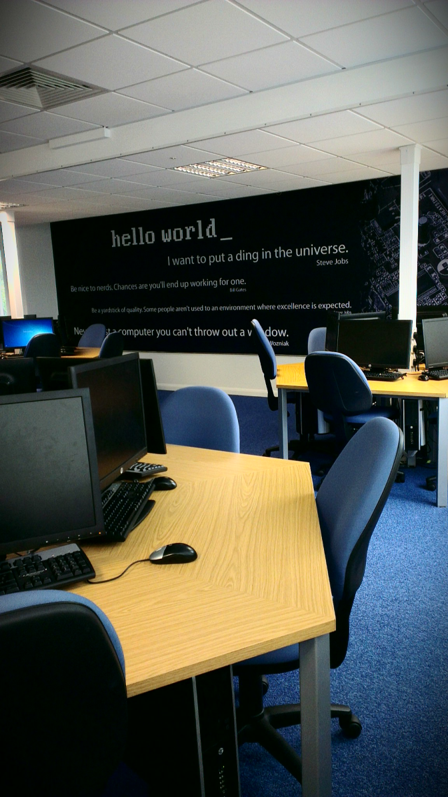
Investment in Facilities
Over £700k spent on labs over two years
£150k spend on workstations and more

Slide 10
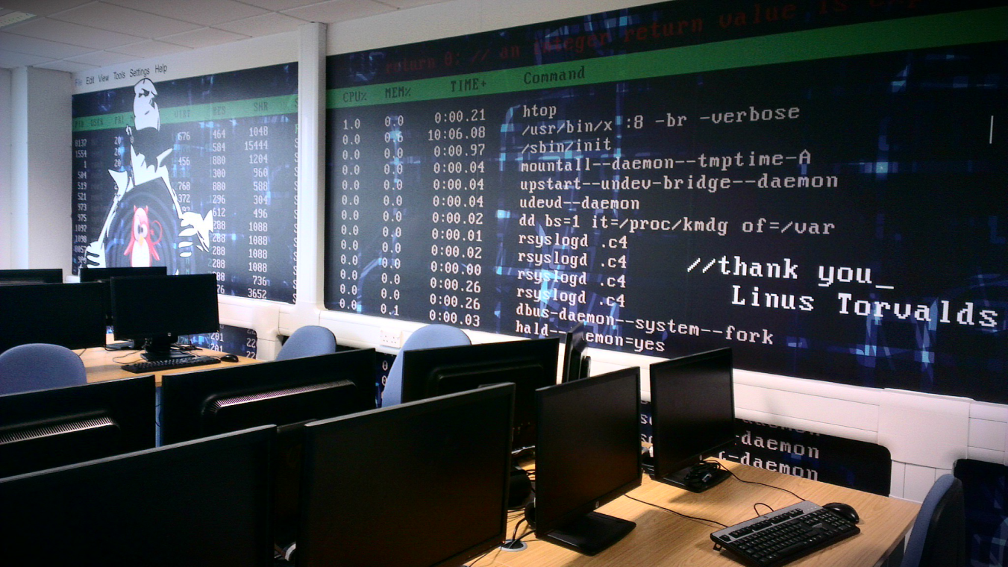
Investment in Facilities (2)
Over £200k on back end servers
£70k on new HPC environment

Slide 11
Year 2 - Partial Specialisation
Students choose one of three routes/pathways:
  Business route
  Leading to degree titles Business IT and IT Management
  Computing route
  Leading to degree titles Computing, Computer Networks, Software Engineering
  Forensics/Security route
  Leading to the Forensic Computing & Security degree.

Slide 12
Year 2 - Structure (1)
All students study six units in Year 2, organised into three types of units, as follows:
  “Signature” units, specific to their chosen route
  Core units, taken by all students
  Optional units
Signature units are:
  Business route - Business for IT
  Computing route - Network & Software Engineering
  Forensics/security route
  - Digital Forensics
  - Ethical Hacking & Countermeasures

Slide 13
Year 2 - Structure (2)
Core units (taken by all students)
  Infrastructure Strategy
  Project Management and Teamworking
  (students work on route-specific group projects)
  Systems Design
Optional units (chosen from the following):
  Application Programming
  Web Programming
  Web Technology Integration
  Data Management (core for Business route but optional for other routes)

Slide 14
Placement Year (Year 3)
Very important part of the course
  Put into practice what you have learned in the first two years
  Gain valuable industrial experience
  Gain competitive edge in finding a job after graduation
Placements last a minimum of 40 weeks
  Paid positions, with large or small companies, in UK or abroad
Our Placement Service helps students find and apply for suitable placements
  Also provides supervision while on placement

Slide 15
Typical Placement and Graduate Employers
Adido Solutions
CISCO Systems
County Councils (various)
DEK Printing Machines
Estee Lauder
Google UK
Hewlett Packard
House of Fraser
IBM
Intel
Lockheed Martin UK
Microsoft UK
Micronav
Ministry of Defence
Nationwide Building Soc
NHS
Oracle Corporation
QinetiQ
School / College IT Departments (various)
Siemens
Xerox

Slide 16

Final Year (Year 4)
You enter Year 4 having made your final choice of degree title and the final year taught units you wish to study
  These choices are inter-related, most titles mandating 2 taught units, with a free choice for your third unit
  However, BSc (Hons) Computing is designed as a generic degree title that allows a more eclectic choice of units
Semester 1 (October to late January)
Study 3 taught units, with exams in January
Semester 2 (late January to May)
Work on individual project/dissertation

Slide 17
Current Final Year Taught Units
Advanced Development
Advanced Networks
Business Development & Enterprise
Business Processes & Requirements
Cyber Crime
Data Mining
Human Factors in
Computing Systems
Machine Intelligence for Business Decision Making
Information Assurance
Management in Computing
Network Configuration Management
Software Quality & Testing
Software Systems Modelling
Ubiquitous & Pervasive
Computing Systems
Web Information Systems

Slide 18
Individual Project
Students work full-time during the 2nd semester on a project of their choice, involving:
  Written dissertation (10,000 words)
  Independent practical work e.g. software build, network specification/design, experiment, analysis, design, detailed business report, etc
  Often working for a real customer
Individual Project Supervisor
Project Tutor oversees all

Slide 19
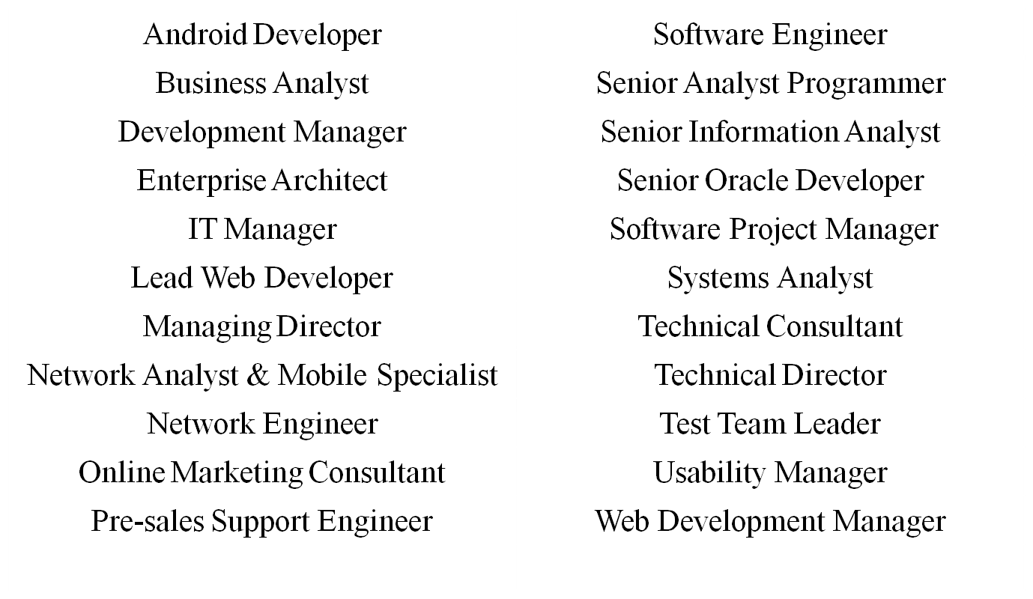
Our Graduates Ten Years On

Slide 20





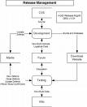
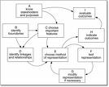
What We Offer You
Technical Skills
Building systems
Programming, databases, networks, web applications
Analytical Skills
Understanding, modelling & solving problems
Improving business processes with intelligent application of IT
Challenge, and the opportunity to excel
E.g. World finalists in Microsoft’s Imagine Cup
E.g. Top IT/Computing graduate in Graduate 100 awards

Slide 21
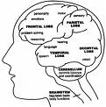


What We Want From You
Intelligence and creativity
  in analysis and problem solving
  in technical solutions
      Ability to communicate
        to explain your proposed solutions
        to work with others
Hard work and commitment
to study!

Slide 22

Questions?

Slide 23
What We Have Covered
Overview of the course structure
Highlights from our successes
Importance of the integral placement year
What we offer
What we expect from our students
Next steps

Slide 24
Questions?
For further questions after today's event, please contact askBU, our centralised hub for enquiries:
  Email: askBUenquiries@bournemouth.ac.uk
  Call: Monday - Friday 08:30 - 17:30
  + 44 (0)1202 961916
Download these slides from next week at: http://dec.bmth.ac.uk/staff/rg/

